Slide 1

IOT HR Monitor
Presented by Greg McIntyre & Tiffany Gray
Notes:
G - “Hello and welcome my name is Greg..” T – “and my name is Tiffany and we would like to introduce our Internet of things, network connected heart rate monitor..”

Slide 2
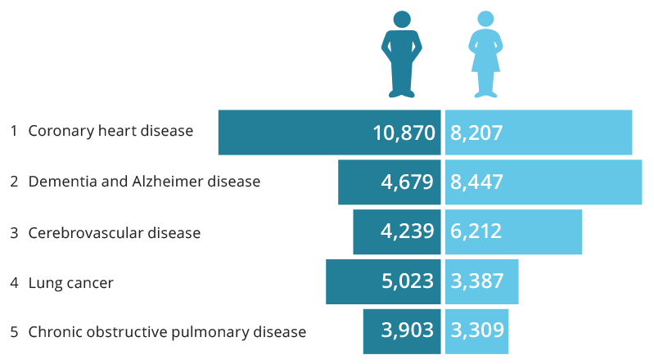
Leading causes of death by sex in 2016
Notes:
In Australia Coronary heart disease is the leading underlying cause of death, followed by dementia, Alzheimer disease, cerebrovascular disease (which includes stroke), lung cancer and chronic obstructive pulmonary disease (COPD).
An estimated 4.2 million (22%) Australian adults aged 18 years and over had 1 or more cardiovascular diseases in 2014–15, based on self-reported data from the Australian Bureau of Statistics 2014–15 National Health Survey. This includes conditions such as coronary heart disease, stroke, heart failure and hypertension.
In 2013, an estimated 65,300 people aged 25 and over had an acute coronary event in the form of a heart attack or unstable angina—around 180 events every day, based on hospitalisations and mortality data.
Graph: https://www.aihw.gov.au/reports/life-expectancy-death/deaths-in-australia/contents/leading-causes-of-death

Slide 3
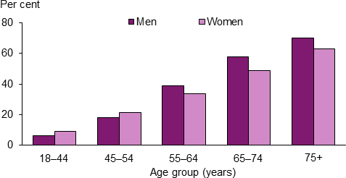
Prevalence of Cardiovascular Disease in Australia from 2014-2015, by age and sex
Notes:
With an aging population also comes the higher risk of heart problems, for example congestive heart failure which is 10 times more likely in the elderly than in younger adults.
There are a few different types of heart failure and as they are chronic progressive conditions it is essential to monitor the hearts performance if cardiovascular issues are known or suspected.
Using a heartrate monitor is a non invasive way to keep track of an individuals heart rate and performance.
Graph: https://www.aihw.gov.au/reports/heart-stroke-vascular-disease/cardiovascular-health-compendium/contents/how-many-australians-have-cardiovascular-disease

Slide 4
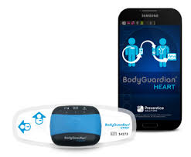
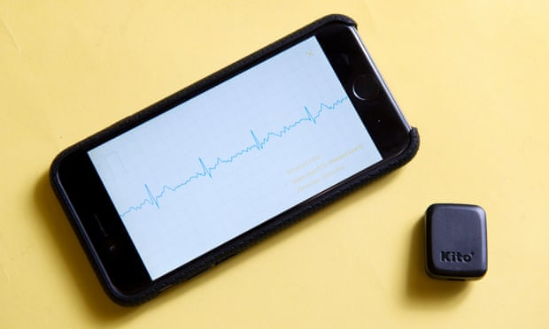
Existing Technology
Notes:
Existing technology:
Left Image: Body Guardian Sensor
Performs cardiac ECG and rhythm monitoring. A body worn sensor allows individuals to remain active and independent while their heart and general health are being monitored. The patient data is wirelessly delivered to the Prevent-ice Care Platform, a cloud-based mHealth platform that collects real-time data from devices and delivers information to physicians.
Right Image: Kito+
The Kito+ has two ECG sensors, a skin temperature sensor, a heart rate sensor, and a blood oxygen sensor. After a scan lasting about 30 seconds with the index and middle fingers on each of the sensors, the companion app shows the blood oxygen, heart rate, skin temperature, ECG, and respiration rate.
Information:
https://www.wearable-technologies.com/2015/05/wearables-for-elderly/
http://www.preventicesolutions.com/
https://yourtechexplained.com/2016/04/02/kito-heart-monitor-gsl16/

Slide 5
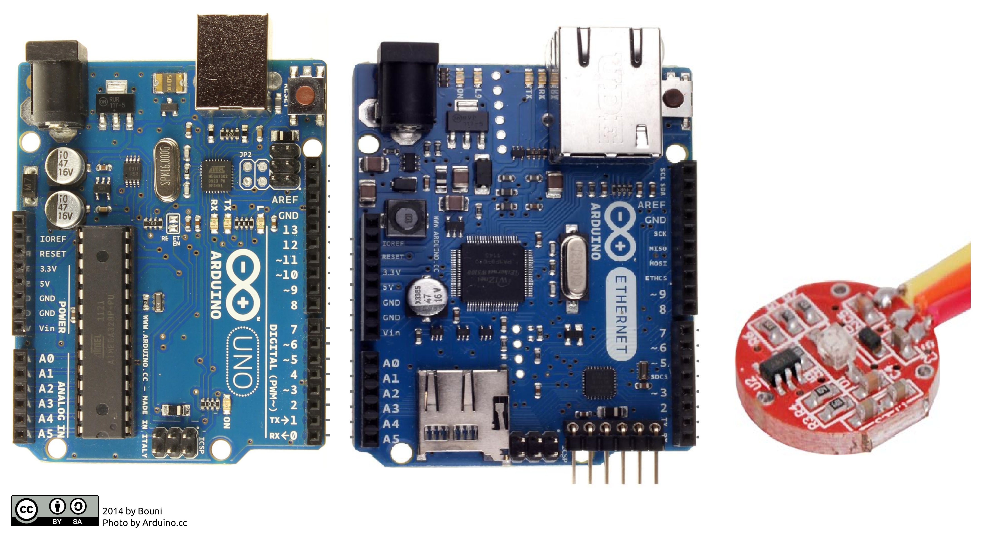
Sense
Notes:
The project will use a HR sensor to collect heart beat data
G – “for this system we will be implementing a sense-think-act cycle. where our system will sense the Heart rate of the user using a simple pulse monitor

Slide 6
Think
Notes:
It will use a collection of this heart rate data to calculate the bpm of the user
G – “the system will then collate the number of pulses into a beats per minute calculation. Using a simple beats per minute measure it will then assess if the heart rate is within regular or irregular ranges”

Slide 7
Act
Notes:
If the heart rate is outside of normal levels it will alert using the ethernet shield.
g- “ the systems will then act on this information by either, doing nothing if the heart rate is within regular ranges or sending an alert if the heart rate is irregular” “our primary iteration of this system if this system we intend to use an Arduino ethernet shield to transmit the information to a web server, this allows for future iterations to implement email or sms”

Slide 8
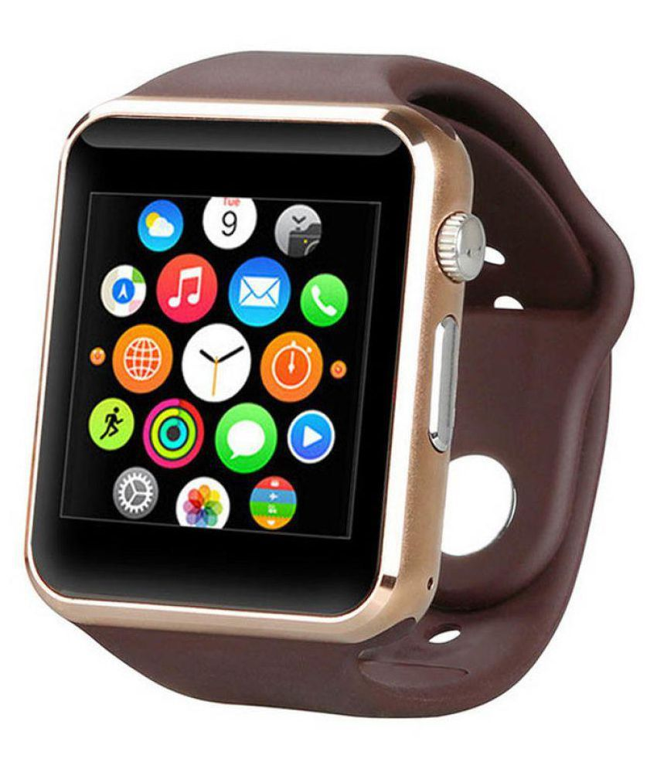
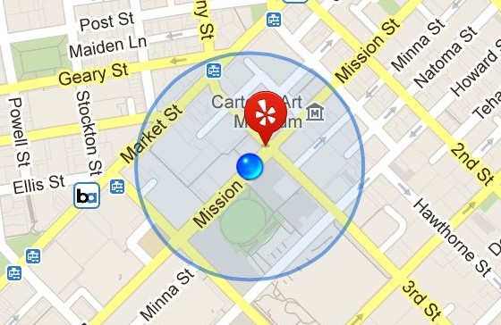
Future Tech
Notes:
Stand alone, simple, easy to use.
G - “the value of this product comes from its independence from user interaction, a stand alone HR monitoring system removes the technology barriers of modern smart phones or smart devices that may be difficult for the aged to operate or simply too small. The systems automated alert system may reduce emergency response times. This system could be integrated into many communication mediums including SMS, email or even into local wireless networks of aged care facilities for local monitoring purposes. Future iterations could be integrated into blood pressure monitors and fall monitors.”

Slide 9
Thank you for your time!
Please contact us at hrandemail@gmail.com
Notes:
G – “thank you for your time today my name is Greg..”
T – “and my name is Tiffany, please do not hesitate to contact us with your concerns or input we would love to hear from you. Have a great day!”

